Slide 1
CERT Hazard Annexes

Slide 2
Thunderstorms
CERT Hazard Annex 9

Slide 3
Introduction (Annex 9)
All thunderstorms include lightning strikes, which have accounted for roughly 30 deaths each year in the United States
Many thunderstorms include heavy rains that cause flash flooding, the number one cause of death associated with thunderstorms
PM TH-1
CERT Hazard Annex: Thunderstorms
TH-1

Slide 4
Introduction (Annex 9) (continued)
Severe thunderstorms can spawn tornadoes, and they can also produce other hazards
  Hurricane-force winds as high as 150 miles per hour, strong enough to flip cars, vans, and trucks, and seriously disrupt air travel
  Hail as large as softballs, which can destroy things like automobiles, roofs, crops, while posing threats to pets and livestock
PM TH-1
CERT Hazard Annex: Thunderstorms
TH-2

Slide 5
Thunderstorm Impacts
Fatalities
  Typically caused by lightening strikes, flash flooding, high winds, and tornadoes
  Responsible for an average of 30 deaths each year in the United States
Disruptions
  Interrupts transportation, power, and other services
PM TH-1
CERT Hazard Annex: Thunderstorms
TH-3

Slide 6
Watch vs Warning
A watch is issued when the atmosphere is favorable for the development of severe thunderstorms. Citizens should be alert for approaching storms
A warning is issued when severe weather has been reported by spotters or indicated by radar. Warnings indicate imminent danger to life and property to those in the path of the storm
PM TH-2
CERT Hazard Annex: Thunderstorms
TH-4

Slide 7
Thunderstorm Preparedness
Understand the risk
When thunderstorms are predicted, plan to be near sturdy shelter
Pay attention to warnings
When thunder roars, go indoors
Check for hazards in your yard
Bring outdoor furniture inside
Remove dead or overhanging limbs
Consider purchasing surge protectors
PM TH-2
CERT Hazard Annex: Thunderstorms
TH-5

Slide 8
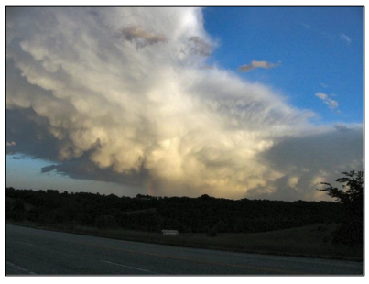
During a Thunderstorm
There are three things to avoid
  Being outdoors
  Water sources
  Telephones
PM TH-2
CERT Hazard Annex: Thunderstorms
TH-6

Slide 9
If You Are Outdoors
Get away from water sources
Seek sturdy shelter in a substantial building
If necessary, take shelter in a car with a metal top and sides
If you are driving, avoid flooded roadways and stop driving if it is hailing
PM TH-3
CERT Hazard Annex: Thunderstorms
TH-7

Slide 10
After a Thunderstorm
Listen to EAS for updated information
Avoid storm-damaged areas
Watch for fallen power lines and trees, and report them immediately
PM TH-3
CERT Hazard Annex: Thunderstorms
TH-8

Slide 11
Final Questions? (Annex 9)
Additional questions, comments, or concerns about severe thunderstorms?
CERT Hazard Annex: Thunderstorms
TH-9

