Slide 1
Unit 7: Light Search and Rescue Operations
CERT Basic Training

Slide 2
Unit 7 Objectives
Identify and apply CERT size-up requirements for potential search and rescue situations
Demonstrate common techniques for light search and rescue
Demonstrate safe techniques for debris removal and survivor extraction during search and rescue operations
PM 7-1
CERT Basic Training Unit 7: Light Search and Rescue Operations
7-1

Slide 3
Unit 7 Topics
Search and Rescue Size-up
Conducting Interior and Exterior Search Operations
Conducting Rescue Operations
PM 7-1
CERT Basic Training Unit 7: Light Search and Rescue Operations
7-2

Slide 4
Search and Rescue
Search and rescue consists of three separate operations
  Size-up: Using 9-step, continual model
  Search: Locating survivors and documenting
  Rescue: Extricating survivors
PM 7-1
CERT Basic Training Unit 7: Light Search and Rescue Operations
7-3

Slide 5
Deciding to Attempt Rescue
Rescue attempt decisions are based on three factors
  Risks involved for the rescuer and survivor
  Greatest good for the greatest number
  Resources and manpower available
PM 7-1
CERT Basic Training Unit 7: Light Search and Rescue Operations
7-4

Slide 6
Goals of Search and Rescue
Rescue greatest number in shortest amount of time
Get walking wounded out first
Rescue lightly trapped survivors next
Keep the rescuers and survivors safe
PM 7-1
CERT Basic Training Unit 7: Light Search and Rescue Operations
7-5

Slide 7
Effective Search and Rescue
Depends on:
  Effective size-up
  Rescuer safety
  Survivor safety
PM 7-1
CERT Basic Training Unit 7: Light Search and Rescue Operations
7-6

Slide 8
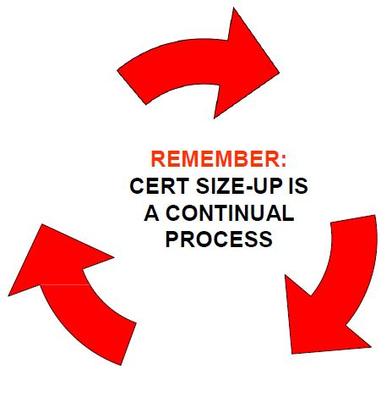
CERT Size-up
Gather Facts
Assess Damage
Consider Probabilities
Assess Your Situation
Establish Priorities
Make Decisions
Develop Plan of Action
Take Action
Evaluate Progress
PM 7-3
CERT Basic Training Unit 7: Light Search and Rescue Operations
7-7

Slide 9
Size-up Step 1
Gather Facts:
  Time of event and day of the week
  Construction type/terrain
  Occupancy
  Weather
  Hazards
  Search subject profile
PM 7-5
CERT Basic Training Unit 7: Light Search and Rescue Operations
7-8

Slide 10
Exercise 7.1
Brainstorm the following questions:
  What does this scenario tell you about the probable density for the affected area?
  What does this scenario tell you about the facts that must be gathered?
  What impact could these facts have on search and rescue operations?
  What kinds of search and rescue operations are probable?
  What, if any, are the constraints that search and rescue personnel may face in this scenario?
  Can these constraints be overcome within the established CERT mission? If so, how?
PM 7-5
CERT Basic Training Unit 7: Light Search and Rescue Operations
7-9

Slide 11
Size-up Step 2
Assess and Communicate Damage
  The CERT mission changes if damage is light, moderate, or heavy
PM 7-6
CERT Basic Training Unit 7: Light Search and Rescue Operations
7-10

Slide 12
Light Damage
Superficial
Broken windows
Superficial cracks or breaks in wall surface
Minor damage to the interior contents
Safe to enter and remain
PM 7-6
CERT Basic Training Unit 7: Light Search and Rescue Operations
7-11

Slide 13
Moderate Damage
Visible signs of damage
Decorative work damaged or fallen
Many visible cracks or breaks in wall
Major damage to interior contents
Building still on foundation
Enter only to save lives
PM 7-6
CERT Basic Training Unit 7: Light Search and Rescue Operations
7-12

Slide 14
Heavy Damage
Partial or total collapse
Tilting
Obvious structural instability
Building off foundation
Smoke, fire, gas leaks, or hazardous material
Rising water
Do not enter a building with heavy damage under any circumstances!
PM 7-7
CERT Basic Training Unit 7: Light Search and Rescue Operations
7-13

Slide 15
Size-up Step 3
Consider Probabilities:
  How stable is the situation?
  What secondary factors should be considered?
  What else could go wrong?
  What does it mean for the search and rescue?
PM 7-8
CERT Basic Training Unit 7: Light Search and Rescue Operations
7-14

Slide 16
Size-up Step 4
Assess Your Situation:
  Is the situation safe enough to continue?
  What risks will rescuers face?
  What resources are needed?
  What resources are available?
PM 7-9
CERT Basic Training Unit 7: Light Search and Rescue Operations
7-15

Slide 17
Rescue Resources
Personnel:
  Firefighters
  Police officers
  Doctors, Nurses
  Contractors
Tools:
  Crowbars
  Auto jacks
  Chainsaws
Equipment
PM 7-9
CERT Basic Training Unit 7: Light Search and Rescue Operations
7-16

Slide 18
Size-up Step 5
Establish Priorities:
  What should be done?
  In what order?
  How do you rescue the greatest number in the shortest amount of time?
PM 7-10
CERT Basic Training Unit 7: Light Search and Rescue Operations
7-17

Slide 19
Size-up Step 6
Make Decisions:
  Keep in mind:
    Safety of CERT members
    Life safety for survivors and others
    Protection of the environment
    Protection of property
PM 7-10
CERT Basic Training Unit 7: Light Search and Rescue Operations
7-17

Slide 20
Size-up Step 7
Develop Plan of Action:
  Focus operation on established priorities and decisions
  Provide documentation to give to responding agencies
  Provide documentation to become part of CERT records
PM 7-11
CERT Basic Training Unit 7: Light Search and Rescue Operations
7-17

Slide 21
Size-up Step 8
Take Action:
  Base action on plan developed during Step 7
PM 7-11
CERT Basic Training Unit 7: Light Search and Rescue Operations
7-20

Slide 22
Size-up Step 9
Evaluate Progress:
  Most critical step
  Monitor plan’s effectiveness and safety
PM 7-11
CERT Basic Training Unit 7: Light Search and Rescue Operations
7-21

Slide 23
Exercise 7.2
Given the disaster and the specific building, answer the following questions
  What are the pertinent facts that must be gathered?
  What kind of prediction can you make regarding damage, based on the incident and the building construction?
  What probable search and rescue problems can you identify?
  What specific safety considerations can you identify?
PM 7-12
CERT Basic Training Unit 7: Light Search and Rescue Operations
7-22

Slide 24
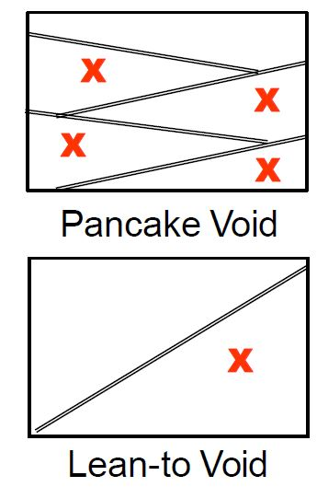
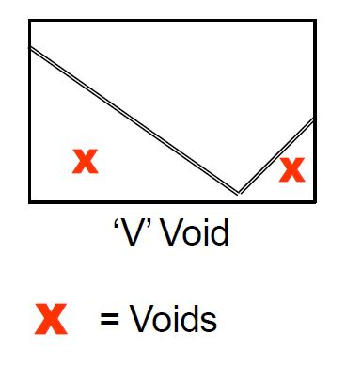
Structural Voids
If you see collapsed floors or walls, GET OUT!
PM 7-13
CERT Basic Training Unit 7: Light Search and Rescue Operations
7-23

Slide 25
Individual Voids
Survivors may seek protection in various places
  Inside bathtubs
  Underneath desks
  Inside cabinets
  Under/next to beds
  Inside closets
PM 7-13
CERT Basic Training Unit 7: Light Search and Rescue Operations
7-24

Slide 26
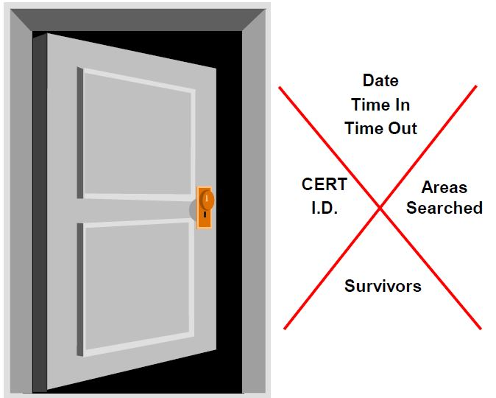
Search Markings (1 of 3)
Upon entering search area:
  Make a slash
  Enter info
Upon leaving search area:
  Complete ‘X’
  Enter info
PM 7-14
CERT Basic Training Unit 7: Light Search and Rescue Operations
7-25

Slide 27
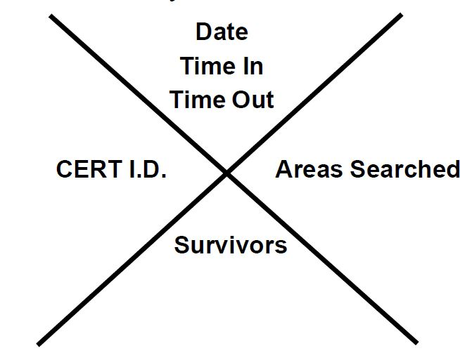
Search Markings (2 of 3)
What information do you mark?
PM 7-14
CERT Basic Training Unit 7: Light Search and Rescue Operations
7-26

Slide 28
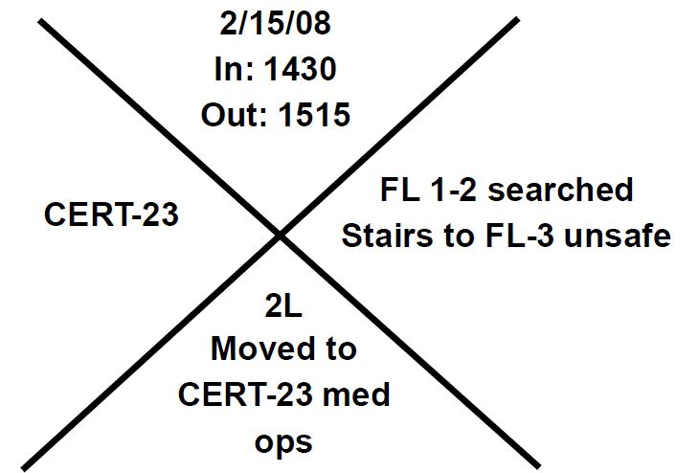
Search Markings (3 of 3)
Sample
PM 7-14
CERT Basic Training Unit 7: Light Search and Rescue Operations
7-27

Slide 29
Search Methodology (1 of 5)
Remain within arm’s reach of one other CERT member
Call out to survivors, “If anyone can hear my voice, come here”
Ask any survivors who do respond for more information about the building or others who may be trapped
Survivors might be in shock or confused
PM 7-14
CERT Basic Training Unit 7: Light Search and Rescue Operations
7-28

Slide 30
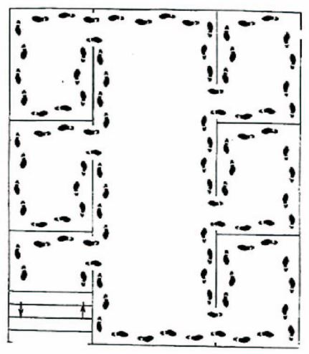
Search Methodology (2 of 5)
Bottom-up/top-down for a multi-story building
Right wall/left wall for a single floor
Stop frequently to listen
PM 7-15
CERT Basic Training Unit 7: Light Search and Rescue Operations
7-29

Slide 31
Search Methodology (3 of 5)
Stop frequently to listen for:
  Tapping
  Movement
  Voices
PM 7-15
CERT Basic Training Unit 7: Light Search and Rescue Operations
7-30

Slide 32
Search Methodology (4 of 5)
Triangulation allows rescuers to view a location from several perspectives
PM 7-15
CERT Basic Training Unit 7: Light Search and Rescue Operations
7-31

Slide 33
Search Methodology (5 of 5)
Keep records of rescued survivors and of those who remain trapped or who are dead
Report information to emergency services personnel
PM 7-15
CERT Basic Training Unit 7: Light Search and Rescue Operations
7-32

Slide 34

Exterior Search
Set up a grid search:
  Set distance between searchers according to visibility and debris
  Overlap patterns for full coverage
  Search in as straight a line as possible
  Mark areas that have been searched
PM 7-15
CERT Basic Training Unit 7: Light Search and Rescue Operations
7-32

Slide 35
Rescue Operations
Remove objects and debris to free survivors and create safe rescue environment
Assess survivors
Remove survivors
PM 7-17
CERT Basic Training Unit 7: Light Search and Rescue Operations
7-34

Slide 36
Creating a Safe Environment
Maintain rescuer safety
Assess survivors in lightly and moderately damaged buildings
Evacuate survivors as quickly as possible
PM 7-17
CERT Basic Training Unit 7: Light Search and Rescue Operations
7-35

Slide 37
Precautions to Minimize Risk
Know your limitations
Follow safety procedures
Remove debris by leveraging and cribbing
PM 7-17
CERT Basic Training Unit 7: Light Search and Rescue Operations
7-36

Slide 38
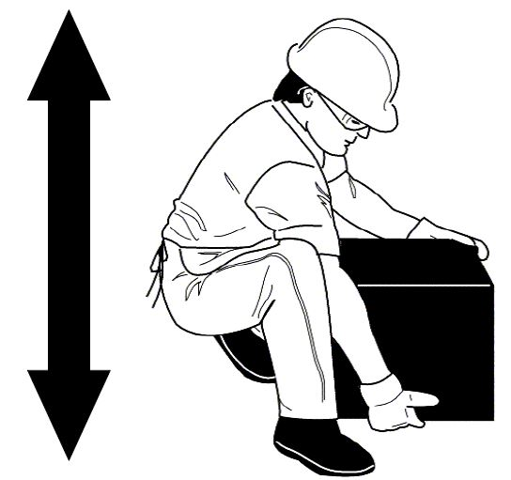
Proper Lifting Procedures
Back straight
Bend knees
Keep load close to body
Push up with legs
PM 7-18
CERT Basic Training Unit 7: Light Search and Rescue Operations
7-37

Slide 39
Leveraging and Cribbing
For heavy lifting
Performed in tandem
Helps extricate survivors
Various materials and objects may be used
PM 7-18
CERT Basic Training Unit 7: Light Search and Rescue Operations
7-38

Slide 40
Two Types of Removal
Self removal or assist; and
Lifts and drags
PM 7-21
CERT Basic Training Unit 7: Light Search and Rescue Operations
7-39

Slide 41
Which Extrication Method?
Extraction method depends on a number of criteria
  General stability of the immediate environment
  Number of rescuers available
  Strength and ability of the rescuers
  Condition of survivor
PM 7-21
CERT Basic Training Unit 7: Light Search and Rescue Operations
7-40

Slide 42
One-Person Arm Carry
Lift around survivor’s back and under his or her knees
Lift survivor by keeping your own back straight and lifting with your legs
PM 7-21
CERT Basic Training Unit 7: Light Search and Rescue Operations
7-41

Slide 43
Pack-Strap Carry
PM 7-22
CERT Basic Training Unit 7: Light Search and Rescue Operations
7-42

Slide 44
Two-Person Carry
PM 7-22
CERT Basic Training Unit 7: Light Search and Rescue Operations
7-43

Slide 45
Chair Carry
PM 7-23
CERT Basic Training Unit 7: Light Search and Rescue Operations
7-44

Slide 46
Blanket Carry
PM 7-24
CERT Basic Training Unit 7: Light Search and Rescue Operations
7-45

Slide 47
Log Rolling
PM 7-25
CERT Basic Training Unit 7: Light Search and Rescue Operations
7-46

Slide 48
Blanket Drag
PM 7-25
CERT Basic Training Unit 7: Light Search and Rescue Operations
7-47

Slide 49
Exercise 7.3
Break into teams of seven
Members of your team will volunteer to be “victims” that other team members will move using the drags and carries demonstrated in the class
Use chairs and other items as needed to perform the drags and carries
Trade off “victim” and “rescuer” roles so that everyone on your team has a chance to practice the drags and carries
Know your limits! Do not attempt any lift or carry that will not be safe for you and the victim
PM 7-26
CERT Basic Training Unit 7: Light Search and Rescue Operations
7-48

Slide 50
Exercise 7.4
Break into teams of seven
Your team will be directed to a “damage site.” Consider your plan of action
Enter “damage site” and conduct room search. Locate victims and make plan to extricate them from debris
Leverage and crib as needed to free the survivor
Use appropriate lifts and drags to remove victims from the room (and, if possible, from the building)
If there is a second “damage site,” conduct another rescue operation
PM 7-26
CERT Basic Training Unit 7: Light Search and Rescue Operations
7-49

Slide 51
Unit Summary (Unit 7)
You should know
  How to decide whether to attempt rescue
  The objectives of interior and exterior search and rescue
  How to perform search and rescue size-up
  Building markings
  Rescue functions
  How to remove debris
  How to extricate survivors
PM 7-27
CERT Basic Training Unit 7: Light Search and Rescue Operations
7-50

Slide 52
Homework Assignment (Unit 7)
Read unit to be covered in next session
Bring necessary supplies to next session
Wear appropriate clothes to next session
PM 7-27
CERT Basic Training Unit 7: Light Search and Rescue Operations
7-51

