Slide 1
Unit 6: Fire Safety and Utility Controls
CERT Basic Training

Slide 2
Unit 6 Objectives
Explain the role CERTs play in fire safety and response, including the CERT size-up process and minimum safety precautions
Extinguish a small fire using a fire extinguisher
Identify and reduce potential fire, utility, and hazardous materials hazards at home and in the community
PM 6-1
CERT Basic Training Unit 6: Fire Safety and Utility Controls
6-1

Slide 3
Role of CERTs
CERTs play very important role in fire safety by:
  Extinguishing small fires
  Preventing additional fires by removing fuel sources
  Shutting off utilities
  Assisting with evacuations, when necessary
PM 6-1
CERT Basic Training Unit 6: Fire Safety and Utility Controls
6-2

Slide 4
CERT Priorities
Rescuer safety is number one priority
  Always work with a buddy
  Always wear safety equipment
  CERT Goal:
  Do the greatest good for the greatest number
PM 6-1
CERT Basic Training Unit 6: Fire Safety and Utility Controls
6-3

Slide 5
The Fire Triangle
PM 6-3
CERT Basic Training Unit 6: Fire Safety and Utility Controls
6-4

Slide 6
Classes of Fire
Class A: Ordinary combustibles
Class B: Flammable and combustible liquids
Class C: Energized electrical equipment
Class D: Combustible metals
Class K: Cooking oils
PM 6-3
CERT Basic Training Unit 6: Fire Safety and Utility Controls
6-5

Slide 7
CERT Fire Size-up
Helps CERT volunteers decide:
  Whether to attempt to suppress a fire
  A plan of action
Answers these questions:
  Do my buddy and I have the right equipment?
  Are there other hazards?
  Is the building structurally damaged?
  Can my buddy and I escape?
  Can my buddy and I fight the fire safely?
  Remember: The safety of individual CERT volunteers is always the top priority
PM 6-4
CERT Basic Training Unit 6: Fire Safety and Utility Controls
6-6

Slide 8
Firefighting Resources
Local fire department
Fire alarm system
Sprinkler systems
Portable fire extinguishers
Interior wet standpipes
PM 6-7
CERT Basic Training Unit 6: Fire Safety and Utility Controls
6-7

Slide 9
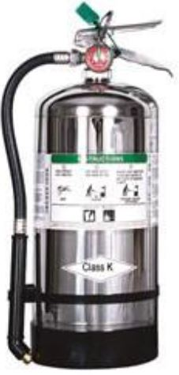
Fire Extinguishers
Water
Dry chemical
Carbon dioxide
Specialized
PM 6-7
CERT Basic Training Unit 6: Fire Safety and Utility Controls
6-8

Slide 10
Extinguisher Rating/Labeling
Labels show types of fires for which that extinguisher is used
  Class A fire ratings: 1A to 40A
  Class B fire ratings: 1B to 640B
Higher number on label = greater amount of extinguishing agent
PM 6-8
CERT Basic Training Unit 6: Fire Safety and Utility Controls
6-9

Slide 11
Sample Label
PM 6-8
CERT Basic Training Unit 6: Fire Safety and Utility Controls
6-10

Slide 12
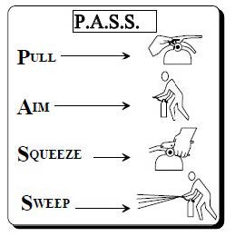
P.A.S.S.
Test the extinguisher after pulling the pin
PM 6-11
CERT Basic Training Unit 6: Fire Safety and Utility Controls
6-11

Slide 13
Interior Wet Standpipes
Usually found in commercial buildings or apartments
CERT volunteers should not operate
PM 6-11
CERT Basic Training Unit 6: Fire Safety and Utility Controls
6-12

Slide 14
Fire Suppression Safety
Safety of individual CERT members is top priority
PM 6-12
CERT Basic Training Unit 6: Fire Safety and Utility Controls
6-13

Slide 15
Fire Suppression Dont’s
Don’t get too close
Don’t try to fight a fire alone
Don’t try to suppress large fires
Don’t enter smoke-filled areas
PM 6-12
CERT Basic Training Unit 6: Fire Safety and Utility Controls
6-14

Slide 16
Reducing Electrical Hazards
Avoid the “electrical octopus”
Don’t run cords under carpets
Check for and replace broken or frayed cords
Maintain appliances
PM 6-14
CERT Basic Training Unit 6: Fire Safety and Utility Controls
6-15

Slide 17
Electrical Emergencies
Know where power shutoffs are
  Appliances
  Circuit breakers
  Fuses
Post shutoff directions next to all utilities
Know procedures for turning power back on after the fire
PM 6-14
CERT Basic Training Unit 6: Fire Safety and Utility Controls
6-16

Slide 18
Shutoff Procedures
Circuit box with shutoff
Fuse box with shutoff
PM 6-14
CERT Basic Training Unit 6: Fire Safety and Utility Controls
6-17

Slide 19
Natural Gas Hazards
Asphyxiant
  Displaces oxygen in the body
Explosive
  Can readily ignite under the right conditions
PM 6-15
CERT Basic Training Unit 6: Fire Safety and Utility Controls
6-18

Slide 20
Natural Gas Hazard Awareness
Install natural gas detector
Install carbon monoxide detector in home
Test batteries for natural gas and carbon monoxide detectors every month
  Change batteries every six months
Locate and label gas shutoffs
  Have proper non-sparking tool
PM 6-15
CERT Basic Training Unit 6: Fire Safety and Utility Controls
6-19

Slide 21
Gas Shutoff
Locate and label gas shutoff valves
If not automatic, know procedures for shutting off gas
PM 6-16
CERT Basic Training Unit 6: Fire Safety and Utility Controls
6-20

Slide 22
L.I.E.S.
Always read labels
Use L.I.E.S. storage procedures
  (Limit, Isolate, Eliminate, Separate)
PM 6-17
CERT Basic Training Unit 6: Fire Safety and Utility Controls
6-21

Slide 23
Hazardous Materials
Corrode other materials
Explode or are easily ignited
React strongly with water
Are unstable when exposed to heat or shock
Are otherwise toxic to humans, animals, or the environment through absorption, inhalation, injection, or ingestion
PM 6-18
CERT Basic Training Unit 6: Fire Safety and Utility Controls
6-22

Slide 24
Identifying Stored Hazardous Materials
PM 6-19
CERT Basic Training Unit 6: Fire Safety and Utility Controls
6-23

Slide 25
The White Quadrant
NFPA 704 Diamond White Quadrant:
  W: Shows unusual reactivity with water
  OX: Possesses oxidizing properties
PM 6-19
CERT Basic Training Unit 6: Fire Safety and Utility Controls
6-24

Slide 26
STOP!
CERT Basic Training Unit 6: Fire Safety and Utility Controls
6-25

Slide 27
Global Harmonized System
PM 6-20
CERT Basic Training Unit 6: Fire Safety and Utility Controls
6-26

Slide 28
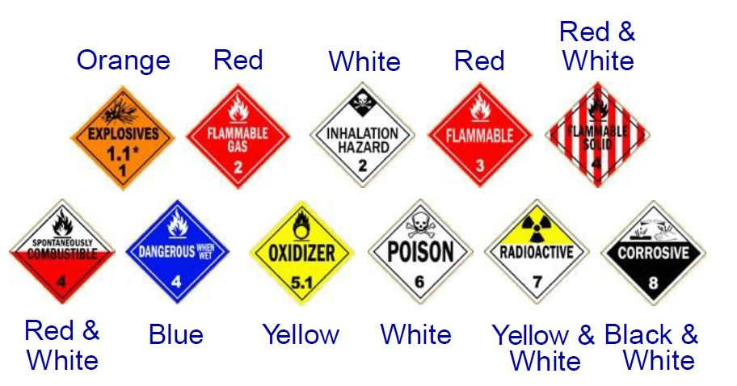
HazMats in Transit
PM 6-21
CERT Basic Training Unit 6: Fire Safety and Utility Controls
6-27

Slide 29
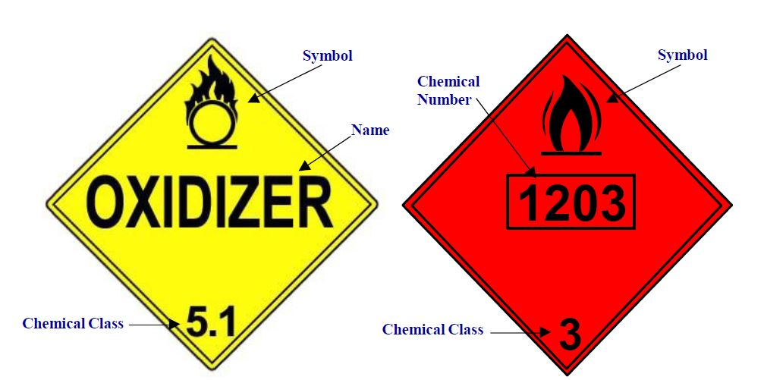
UN and NA Placards
PM 6-21
CERT Basic Training Unit 6: Fire Safety and Utility Controls
6-28

Slide 30
Greater Than 1?
Remember:
All hazardous material placards are a stop sign for CERT volunteers!
CERT Basic Training Unit 6: Fire Safety and Utility Controls
6-29

Slide 31
Exercise 6.1
Practice using a portable fire extinguisher to suppress a small fire
Apply teamwork to fire suppression
PM 6-22
CERT Basic Training Unit 6: Fire Safety and Utility Controls
6-30

Slide 32
Unit Summary (Unit 6)
You should know:
  Keys to effective fire suppression
  Classes of fire and types of fire extinguishers
  P.A.S.S.
  How to identify hazardous materials
  Always follow the safety rules established for CERTs. Personal safety comes first!
PM 6-23
CERT Basic Training Unit 6: Fire Safety and Utility Controls
6-31

Slide 33
Homework Assignment (Unit 6)
Read unit to be covered in next session
Bring necessary supplies to next session
Wear appropriate clothes to next session
PM 6-23
CERT Basic Training Unit 6: Fire Safety and Utility Controls
6-32

