Slide 1
Unit 3: Disaster Medical Operations - Part 1
CERT Basic Training

Slide 2
Unit 3 Objectives
Identify life-threatening conditions resulting from trauma including severe bleeding, low body temperature, and airway blockage
Apply correct life saving techniques
Provide basic first-aid care for non-life threatening injuries
PM 3-1
CERT Basic Training Unit 3: Disaster Medical Operations – Part 1
3-1

Slide 3
Treating Life-Threatening Conditions
Without treatment, severe bleeding and airway obstruction can quickly lead to death
The first priority of CERT volunteers assisting in disaster medical operations is to attend to these conditions by controlling bleeding and positioning a patient so they can breathe
PM 3-2
CERT Basic Training Unit 3: Disaster Medical Operations – Part 1
3-2

Slide 4
Safety Considerations
Prior to treatment, ensure that both the patient and rescuer are in a safe environment to administer care
Some questions CERT volunteers to consider
  Do I feel safe at this spot?
  Should I leave and move to a safer location, or am I able to stay and start providing care immediately?
  If I leave, can I take anyone with me?
PM 3-2
CERT Basic Training Unit 3: Disaster Medical Operations – Part 1
3-3

Slide 5
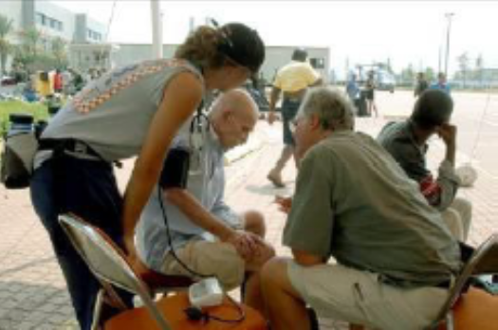
Approaching the Patient
Be sure patient can see you
Identify yourself
  Your name and name of your organization
Request permission to treat, if possible
Respect cultural differences
Protect patient privacy
PM 3-2
CERT Basic Training Unit 3: Disaster Medical Operations – Part 1
3-4

Slide 6
Life-Threatening Bleeding
Indicators of life-threatening bleeding:
  Spurting/steady bleeding
  Blood is pooling
  Blood is soaking through over lying clothes
  Blood is soaking through bandages
  Amputation
PM 3-3
CERT Basic Training Unit 3: Disaster Medical Operations – Part 1
3-5

Slide 7
Stages of Severe Bleeding
Stage | Blood Loss | Heart Rate | Blood Pressure | Breath Rate | Patient
I | Less than 15% | Normal (<100 bpm) | Normal | 14-20 | Patient appears normal
II | 15%-40% | Fast (>100 bpm) | Slightly Low | 20-30 | Patient may feel anxious
III | 30%-40% | Very Fast (>120 bpm) | Low | 30-40 | Patient feels confused
IV | Greater than 40% | Critical (>140 bpm) | Critical | >35 | Patient feels lethargic
PM 3-3
CERT Basic Training Unit 3: Disaster Medical Operations – Part 1
3-6

Slide 8
Types of Bleeding
Arterial bleeding: Arteries transport blood under high pressure
  Blood coming from an artery will spurt
Venous bleeding: Veins transport blood under low pressure
  Blood coming from a vein will flow
Capillary bleeding: Capillaries also carry blood under low pressure
  Blood coming from capillaries will ooze
PM 3-3
CERT Basic Training Unit 3: Disaster Medical Operations – Part 1
3-7

Slide 9
Types of Bleeding (image)
PM 3-3
CERT Basic Training Unit 3: Disaster Medical Operations – Part 1
3-8

Slide 10
Controlling Bleeding: Direct Pressure
Step 1: Find the source(s)
Step 2: Cover the source
Step 3: Apply pressure
Step 4: Maintain pressure until bleeding has stopped
PM 3-3
CERT Basic Training Unit 3: Disaster Medical Operations – Part 1
3-9

Slide 11
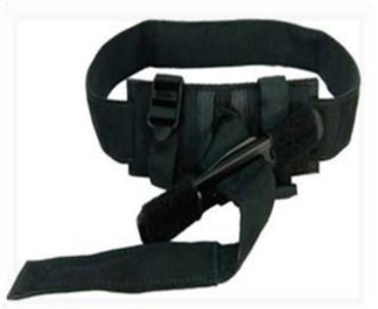
Controlling Bleeding: Tourniquets
Place on injured limb as high as possible
Pull strap through buckle
Twist rod until bleeding stops/slows
Secure the rod
If bleeding continues, place second tourniquet
Leave in place until EMS takes over
PM 3-4
CERT Basic Training Unit 3: Disaster Medical Operations – Part 1
3-10

Slide 12
Shock
Shock is often difficult to diagnose
Main signs of shock:
  Rapid and shallow breathing
  Capillary refill of greater than two seconds
  Failure to follow simple commands, such as “squeeze my hand
Symptoms of shock are easily missed. Pay careful attention to your patient
PM 3-5
CERT Basic Training Unit 3: Disaster Medical Operations – Part 1
3-11

Slide 13
Maintaining Body Temperature
Keep the patient warm
  Remove wet clothing
  Place something between patient and ground (e.g., cardboard, jacket, blanket)
  Wrap patient with dry layers (e.g., coat, blanket, Mylar emergency blanket)
  Shield patient from wind
PM 3-5
CERT Basic Training Unit 3: Disaster Medical Operations – Part 1
3-12

Slide 14
Exercise 3.1
After breaking into pairs, identify one person to take the role of the patient and one to take the role of the rescuer
Respond as if the patient has an injury on the right forearm, just below the elbow
Apply a pressure bandage or tourniquet (if available)
Repeat the process twice
Swap roles and have the new rescuer complete the above steps
PM 3-6
CERT Basic Training Unit 3: Disaster Medical Operations – Part 1
3-13

Slide 15
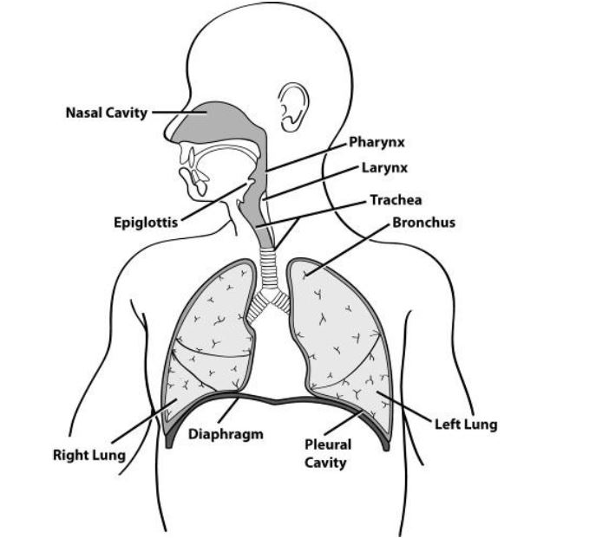
Opening the Airway
PM 3-6
CERT Basic Training Unit 3: Disaster Medical Operations – Part 1
3-14

Slide 16
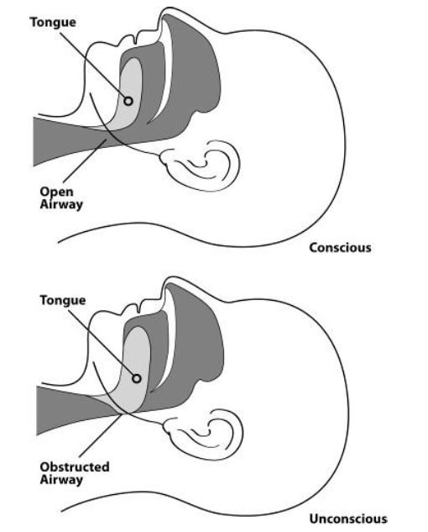
Open vs. Obstructed Airway
PM 3-6
CERT Basic Training Unit 3: Disaster Medical Operations – Part 1
3-15

Slide 17
Positioning a Conscious Patient
When sitting on a raised platform(e.g., chair, bench): Legs shoulder width apart, elbows or hands on knees, and leaning slightly forward
When standing: Legs shoulder width apart, hands on knees arms straight, and leaning forward with flat back
PM 3-6
CERT Basic Training Unit 3: Disaster Medical Operations – Part 1
3-16

Slide 18
Positioning an Unconscious Patient
PM 3-7
CERT Basic Training Unit 3: Disaster Medical Operations – Part 1
3-17

Slide 19
Recovery Position
Body: Laid on its side
Bottom Arm: Reached outward
Top Arm: Rest hand on bicep of bottom arm
Head: Rest on hand
Legs: Bent slightly
Chin: Raised forward
Mouth: Pointed downward
PM 3-7
CERT Basic Training Unit 3: Disaster Medical Operations – Part 1
3-18

Slide 20
Jaw-thrust Maneuver
Kneel above the patient’s head
Put one hand on each side of the patient’s head with the thumbs near the corners of the mouth pointed toward the chin, using the elbows for support
Slide the fingers into position under the angles of the patient’s jawbone without moving the head or neck
Thrust the jaw upward without moving the head or neck to lift the jaw and open the airway
PM 3-7
CERT Basic Training Unit 3: Disaster Medical Operations – Part 1
3-19

Slide 21
Exercise 3.2
Break into pairs and have one person play the rescuer and one person play the patient
Assume that the unconscious injured individual is breathing
Place them into the recovery position using the technique you just learned
PM 3-8
CERT Basic Training Unit 3: Disaster Medical Operations – Part 1
3-20

Slide 22
Providing Comfort
What can you do?
  Keep them warm
  Offer a hand to hold
  Maintain eye contact
  Be patient and understanding
  If you have to move on to provide aid to another person, let them know
PM 3-8
CERT Basic Training Unit 3: Disaster Medical Operations – Part 1
3-21

Slide 23
Treating Burns
Prevent hypothermia
Manage pain
Reduce risk of infection
PM 3-9
CERT Basic Training Unit 3: Disaster Medical Operations – Part 1
3-22

Slide 24
Burn Severity
Factors that affect burn severity:
  Temperature of burning agent
  Period of time survivor exposed
  Area of body affected
  Size of area burned
  Depth of burn
PM 3-9
CERT Basic Training Unit 3: Disaster Medical Operations – Part 1
3-23

Slide 25
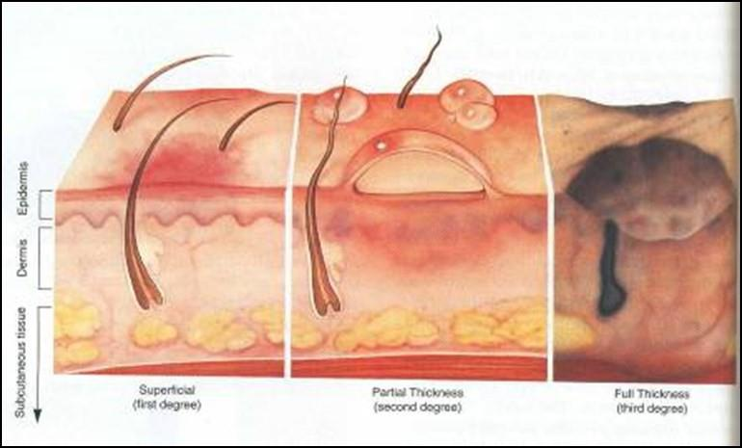
Burn Classifications
Superficial: epidermis
Partial Thickness: dermis and epidermis
Full Thickness: subcutaneous layer and all layers above
PM 3-9
CERT Basic Training Unit 3: Disaster Medical Operations – Part 1
3-24

Slide 26
Treatment for Chemical Burns
Remove cause of burn and affected clothing or jewelry
If irritant is dry, gently brush away as much as possible
  Always brush away from eyes, survivor, and yourself
Flush with lots of cool running water
Apply cool, wet compress to relieve pain
Cover wound loosely with dry, sterile or clean dressing
PM 3-10
CERT Basic Training Unit 3: Disaster Medical Operations – Part 1
3-25

Slide 27
Wound Care
Main treatment for wounds:
  Control bleeding
  Apply dressing and bandage
Apply dressing and bandage:
  Apply dressing directly to wound
  Bandage holds dressing in place
PM 3-11
CERT Basic Training Unit 3: Disaster Medical Operations – Part 1
3-26

Slide 28
Rules of Dressing
If active bleeding:
  Redress OVER existing dressing
If no active bleeding:
  Maintain the pressure and keep wound bandaged until further treatment by a medical professional
PM 3-11
CERT Basic Training Unit 3: Disaster Medical Operations – Part 1
3-27

Slide 29
Signs of Infection
Signs of possible infection:
  Swelling around wound site
  Discoloration
  Discharge from wound
  Red striations from wound site
PM 3-11
CERT Basic Training Unit 3: Disaster Medical Operations – Part 1
3-28

Slide 30
Amputations
If amputated body part is found:
  Save tissue parts, wrapped in clean material and placed in plastic bag
  Keep tissue parts cool, but NOT directly on ice
  Keep severed part with survivor
PM 3-11
CERT Basic Training Unit 3: Disaster Medical Operations – Part 1
3-29

Slide 31
Impaled Objects
When foreign object is impaled in patient’s body:
  Immobilize affected body part
  Do not attempt to move or remove
  Try to control bleeding at entrance wound
  Clean and dress wound, making sure to stabilize impaled object
PM 3-12
CERT Basic Training Unit 3: Disaster Medical Operations – Part 1
3-30

Slide 32
Fractures, Dislocations, Sprains, Strains
Immobilize injury and joints immediately above and below injury site
If uncertain of injury type, treat as fracture
PM 3-12
CERT Basic Training Unit 3: Disaster Medical Operations – Part 1
3-31

Slide 33
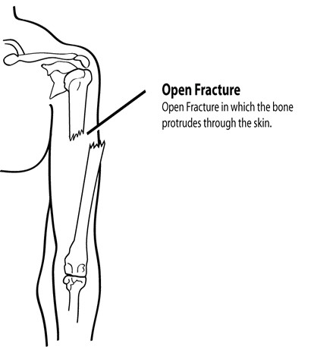
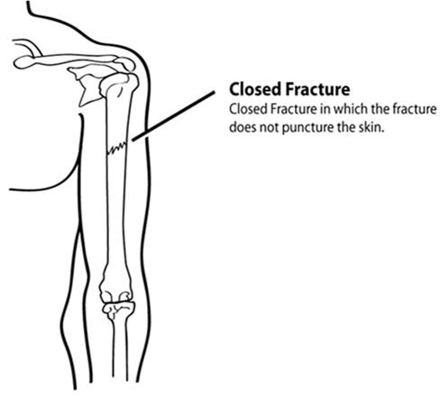
Types of Fractures (1 of 2)
PM 3-12
CERT Basic Training Unit 3: Disaster Medical Operations – Part 1
3-32

Slide 34
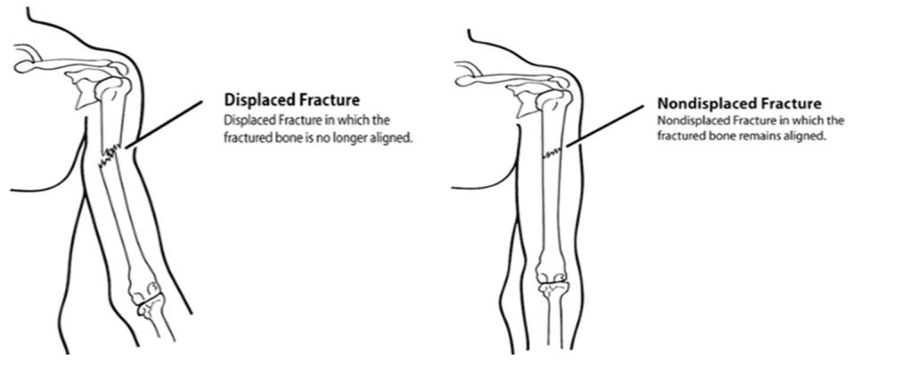
Types of Fractures (2 of 2)
PM 3-13
CERT Basic Training Unit 3: Disaster Medical Operations – Part 1
3-33

Slide 35
Treating Open Fractures
Do not draw exposed bone ends back into tissue
Do not irrigate wound
Cover wound with sterile dressing
Splint fracture without disturbing wound
Place moist dressing over bone end
PM 3-13
CERT Basic Training Unit 3: Disaster Medical Operations – Part 1
3-34

Slide 36
Dislocations
Dislocation is injury to ligaments around a joint
  It is so severe that it permits separation of bone from its normal position in a joint
Treatment:
  Immobilize; do NOT relocate
  Check Pulse, Movement, and Sensation (PMS) before and after splinting/immobilization
PM 3-13
CERT Basic Training Unit 3: Disaster Medical Operations – Part 1
3-35

Slide 37
Signs of Sprain
Tenderness at site
Swelling and bruising
Restricted use or loss of use
PM 3-14
CERT Basic Training Unit 3: Disaster Medical Operations – Part 1
3-36

Slide 38
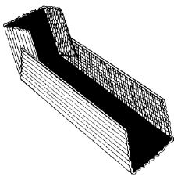
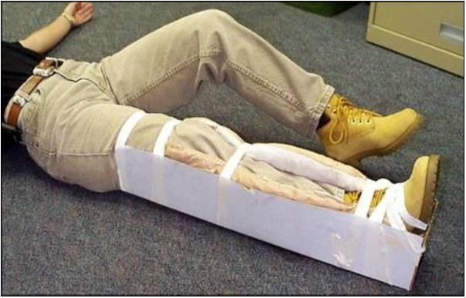
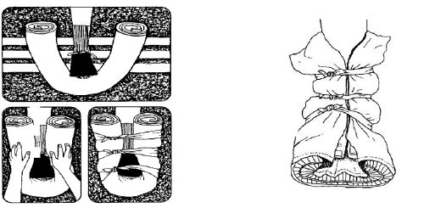
Splinting
PM 3-14
CERT Basic Training Unit 3: Disaster Medical Operations – Part 1
3-37

Slide 39
Cold-Related Injuries
Hypothermia:
  Occurs when body’s temperature drops below normal
Frostbite:
  Occurs when extreme cold shuts down blood flow to extremities, causing tissue death
PM 3-16
CERT Basic Training Unit 3: Disaster Medical Operations – Part 1
3-38

Slide 40
Symptoms of Hypothermia
Body temperature of 95°F or lower
Redness or blueness of skin
Numbness and shivering
Slurred speech
Unpredictable behavior
Listlessness
PM 3-16
CERT Basic Training Unit 3: Disaster Medical Operations – Part 1
3-39

Slide 41
Hypothermia Treatment
Remove wet clothing
Put something under the patient
Keep them sheltered and/or covered
Do not attempt to use massage
Place in the recovery position if unconscious
PM 3-16
CERT Basic Training Unit 3: Disaster Medical Operations – Part 1
3-40

Slide 42
Symptoms of Frostbite
Skin discoloration
Burning or tingling sensation
Partial or complete numbness
PM 3-16
CERT Basic Training Unit 3: Disaster Medical Operations – Part 1
3-41

Slide 43
Frostbite Treatment
Immerse injured area in warm (NOT hot) water
  Warm slowly!
Do not allow part to re-freeze
Do not attempt to use massage
Wrap affected body parts in dry, sterile dressing
PM 3-16
CERT Basic Training Unit 3: Disaster Medical Operations – Part 1
3-42

Slide 44
Heat-Related Injuries
Heat cramps
  Muscle spasms brought on by over-exertion in extreme heat
Heat exhaustion
  Occurs when exercising or working in extreme heat results in loss of body fluids
Heat stroke
  Survivor’s temperature control system shuts down
  Body temperature rises so high that brain damage and death may result
PM 3-17
CERT Basic Training Unit 3: Disaster Medical Operations – Part 1
3-43

Slide 45
Symptoms of Heat Exhaustion
Cool, moist, pale or flushed skin
Heavy sweating
Headache
Nausea or vomiting
Dizziness
Exhaustion
PM 3-17
CERT Basic Training Unit 3: Disaster Medical Operations – Part 1
3-44

Slide 46
Symptoms of Heat Stroke
Hot, red skin
Lack of perspiration
Changes in consciousness
Rapid, weak pulse and rapid, shallow breathing
PM 3-17
CERT Basic Training Unit 3: Disaster Medical Operations – Part 1
3-45

Slide 47
Treatment of Heat-Related Injuries
Remove from heat to cool environment
Cool body slowly
Have the heat exhaustion patient drink water, SLOWLY
Do not provide food or drink to the patient if he or she is experiencing vomiting, cramping, or is losing consciousness
PM 3-18
CERT Basic Training Unit 3: Disaster Medical Operations – Part 1
3-46

Slide 48
Treatment for Bites/Stings
If bite or sting is suspected, and situation is non-emergency:
  Remove stinger if still present by scraping edge of credit card or other stiff, straight-edged object across stinger
  Wash site thoroughly with soap and water
  Place ice on site for 10 minutes on and 10 minutes off
PM 3-18
CERT Basic Training Unit 3: Disaster Medical Operations – Part 1
3-47

Slide 49
Anaphylaxis
Calm the individual
If possible, find and help administer a patient’s Epi-pen
  Many severe allergy sufferers carry one at all times
Do not administer medicine aside from the Epi-pen
  This includes pain relievers, allergy medicine, etc.
PM 3-18
CERT Basic Training Unit 3: Disaster Medical Operations – Part 1
3-48

Slide 50
Unit Summary (Unit 3)
Life-saving measures CERT volunteers can take:
  Control bleeding using direct pressure and/or a tourniquet
  Maintain normal body temperature
  Open airway and position patient correctly
Other injuries that are common after disasters:
  Burns
  Wounds
  Amputations and impaled objects
  Fractures, dislocations, sprains, and strains
  Cold-related injuries
  Heat-related injuries
  Insect bites/stings
PM 3-19
CERT Basic Training Unit 3: Disaster Medical Operations – Part 1
3-49

Slide 51
Homework Assignment (Unit 3)
Read unit to be covered in next session
Wear appropriate clothes for next session
PM 3-19
CERT Basic Training Unit 3: Disaster Medical Operations – Part 1
3-50

