Slide 1
Unit 2: CERT Organization
CERT Basic Training

Slide 2
Unit 2 Objectives
Describe the CERT organizational structure
Explain the Incident Command System (ICS) and how CERT operates within this structure
Describe the 9-step one-scene size-up process
Describe how to use CERT standard documents
PM 2-1
CERT Basic Training Unit 2: CERT Organization
2-1

Slide 3
Principles of On-Scene Management
Maintain the safety of disaster workers
Provide clear leadership and organizational structure
Improve effectiveness of rescue efforts
PM 2-2
CERT Basic Training Unit 2: CERT Organization
2-2

Slide 4
CERT On-Scene Management
Well-defined management structure
Manageable span of control
Common terminology
Effective communication
Consolidated action plans
Comprehensive resource management
Accountability
PM 2-2
CERT Basic Training Unit 2: CERT Organization
2-3

Slide 5
Objectives for On-Scene Management
Identify scope of incident
Determine overall strategy
Deploy resources
Document actions and results
PM 2-2
CERT Basic Training Unit 2: CERT Organization
2-4

Slide 6
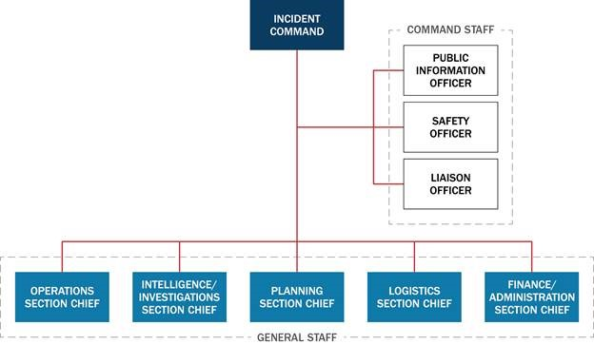
Incident Command System
PM 2-3
CERT Basic Training Unit 2: CERT Organization
2-5

Slide 7
CERT Operations
Command structure
CERT Team Leader
Command Post
Expanded structure as needed
PM 2-5
CERT Basic Training Unit 2: CERT Organization
2-6

Slide 8
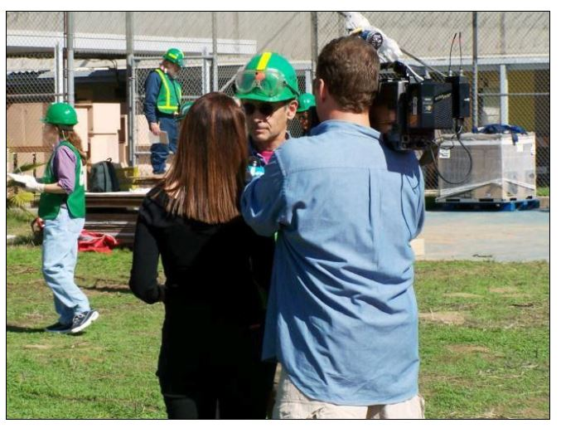
Dealing with the Media
Refer media inquiries to CERT Incident Commander/Team Leader
Do not let media inhibit CERT goals
Be careful about information released
PM 2-6
CERT Basic Training Unit 2: CERT Organization
2-7

Slide 9
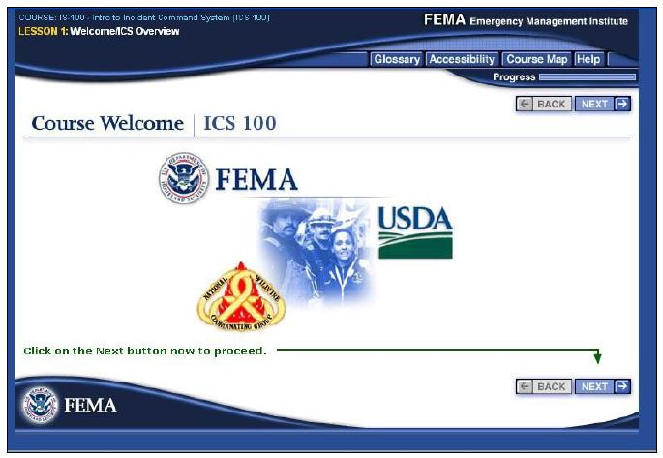
NIMS Implementation
Ability to work together
IS-100: Introduction to ICS
  https://emilms.fema.gov/IS100c/curriculum/1.html
IS-700: Introduction to NIMS
  https://emilms.fema.gov/IS700b/curriculum/1.html
PM 2-6
CERT Basic Training Unit 2: CERT Organization
2-8

Slide 10
Exercise 2.1
Using your knowledge about the ICS functions, decide under which function the following CERT activities would fall. Some activities may involve more than one function to be completed
Use the following key to fill in the blanks before each activity:
  Team Leader = TL
  Operations = O
  Planning = P
  Logistics = L
PM 2-6
CERT Basic Training Unit 2: CERT Organization
2-9

Slide 11
CERT Mobilization
CERTs take care of themselves, their families, their homes, their neighbors
Proceed to predesignated staging area
TL is established, organizes the group
TL prioritizes actions
Organization is flexible and evolves based on new information
PM 2-8
CERT Basic Training Unit 2: CERT Organization
2-10

Slide 12
On-Scene Size-up
Gather Facts
Assess and Communicate Damage
Consider Probabilities
Assess Your Own Situation
Establish Priorities
Make Decisions
Develop Plan of Action
Take Action
Evaluate Progress
PM 2-9
CERT Basic Training Unit 2: CERT Organization
2-11

Slide 13
Rescuer Safety
Rescuer safety = first priority
Heavy damage = No rescue
Moderate damage = Locate, assess, evacuate
Light damage = Locate, assess, continue size-up, and document
PM 2-10
CERT Basic Training Unit 2: CERT Organization
2-12

Slide 14
Documentation
Command Post
  Documents situation status
    Incident locations
    Access routes
    Identified hazards
    Support locations
Section Chiefs
  Provide Command Post with information
PM 2-11
CERT Basic Training Unit 2: CERT Organization
2-13

Slide 15

Documentation (image)
PM 2-11
CERT Basic Training Unit 2: CERT Organization
2-14

Slide 16
Documentation Forms
Damage Assessment
Personnel Resources Sign-In
CERT Assignment Tracking Log
Briefing Assignment
Treatment Area Record
Communications Log
Equipment Inventory
General Message
PM 2-13
CERT Basic Training Unit 2: CERT Organization
2-15

Slide 17
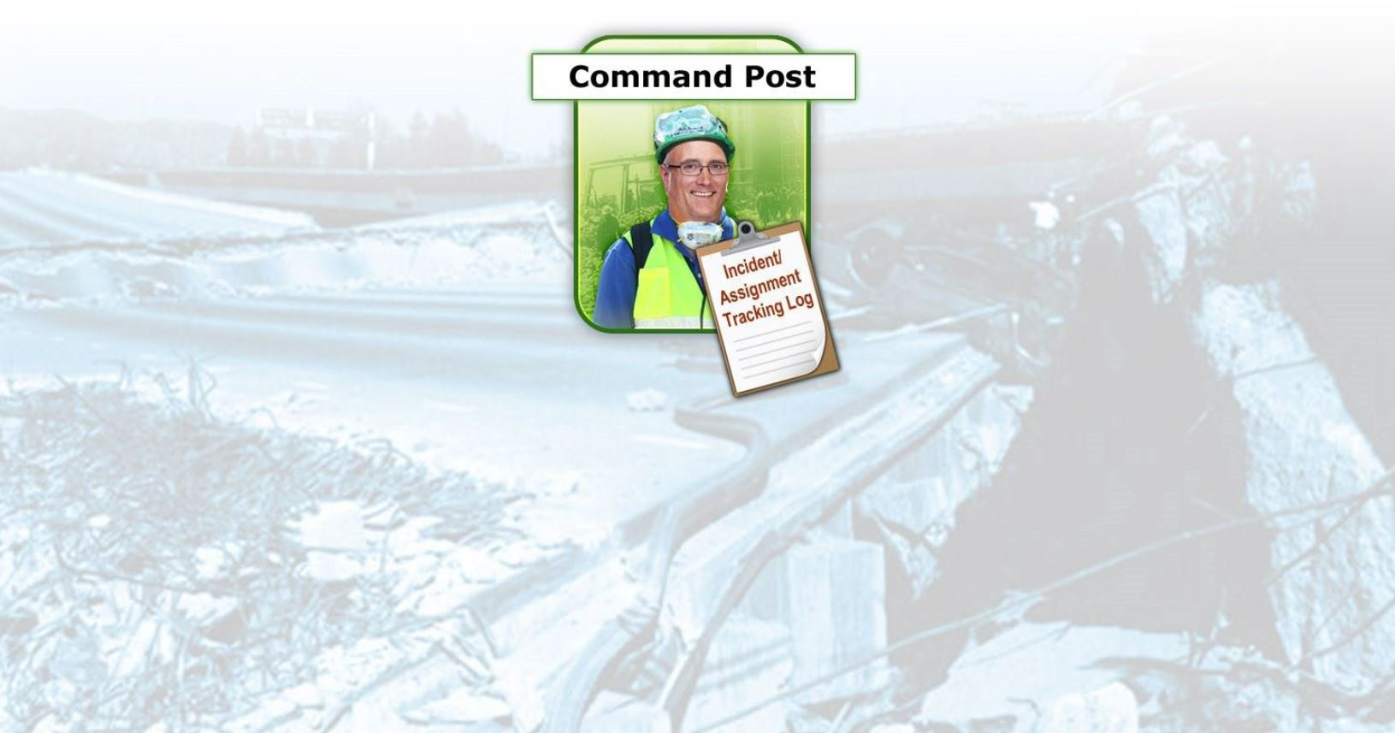
Documentation Flow(1 of 5)
PM 2-13
CERT Basic Training Unit 2: CERT Organization
2-16

Slide 18
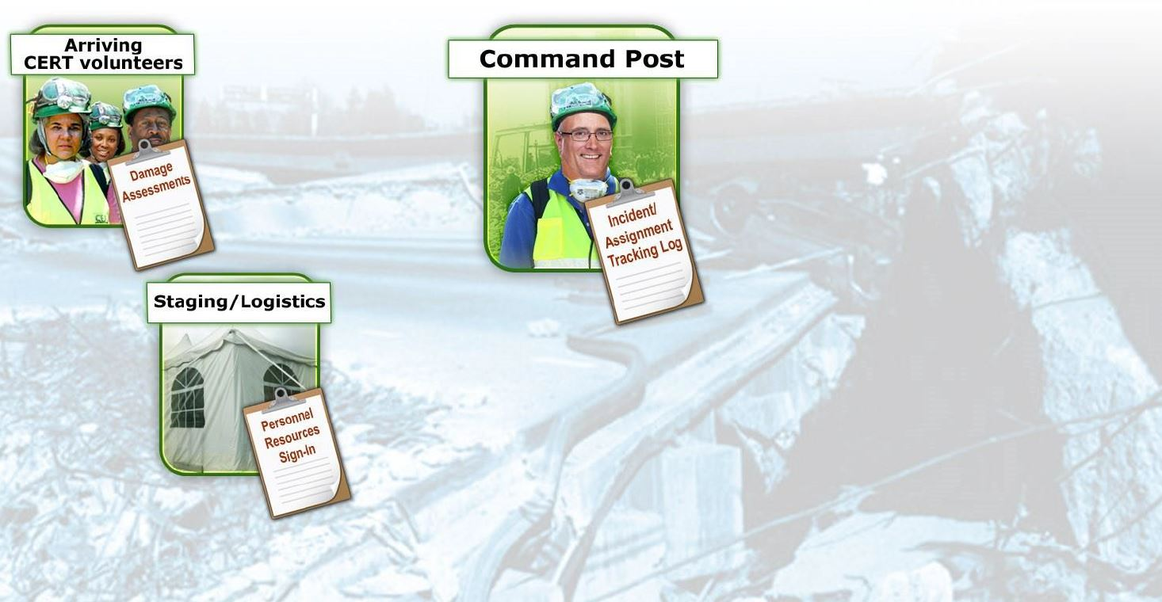
Documentation Flow (2 of 5)
PM 2-13
CERT Basic Training Unit 2: CERT Organization
2-17

Slide 19
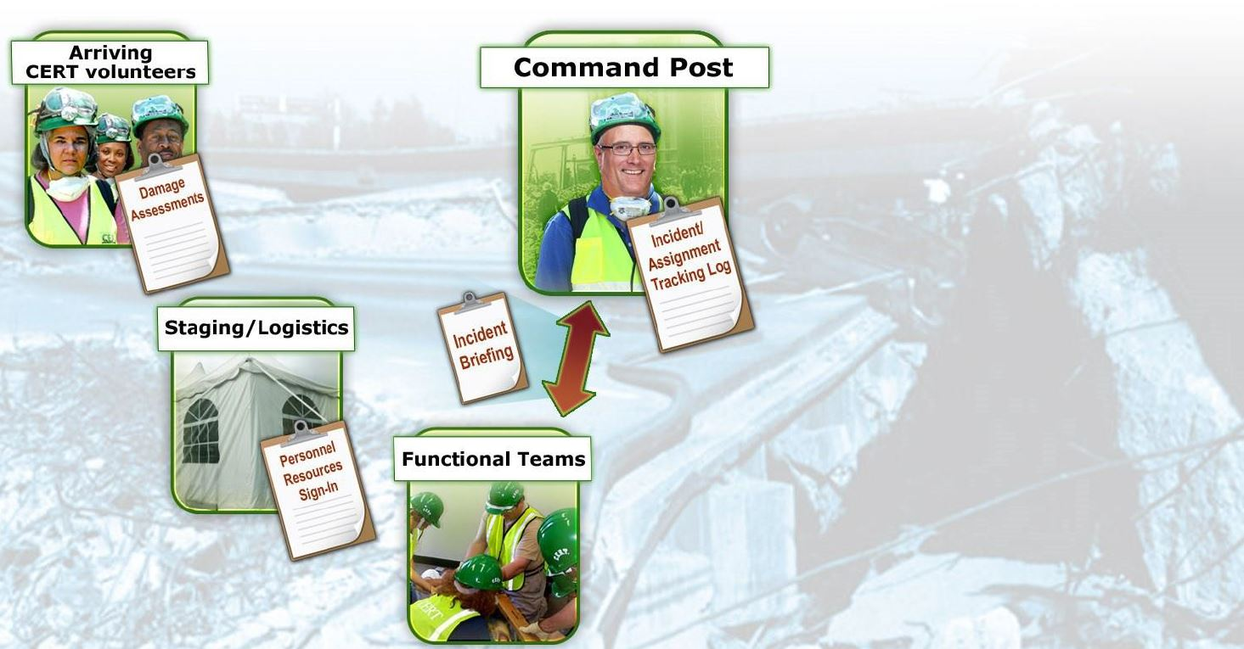
Documentation Flow (3 of 5)
PM 2-13
CERT Basic Training Unit 2: CERT Organization
2-18

Slide 20
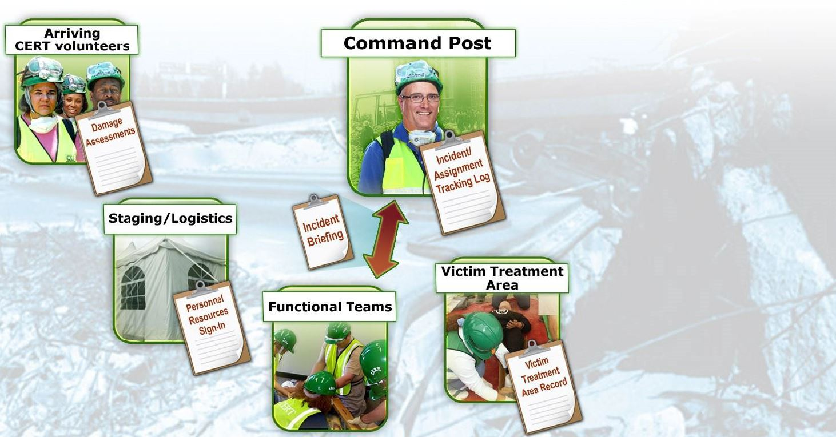
Documentation Flow (4 of 5)
PM 2-13
CERT Basic Training Unit 2: CERT Organization
2-19

Slide 21
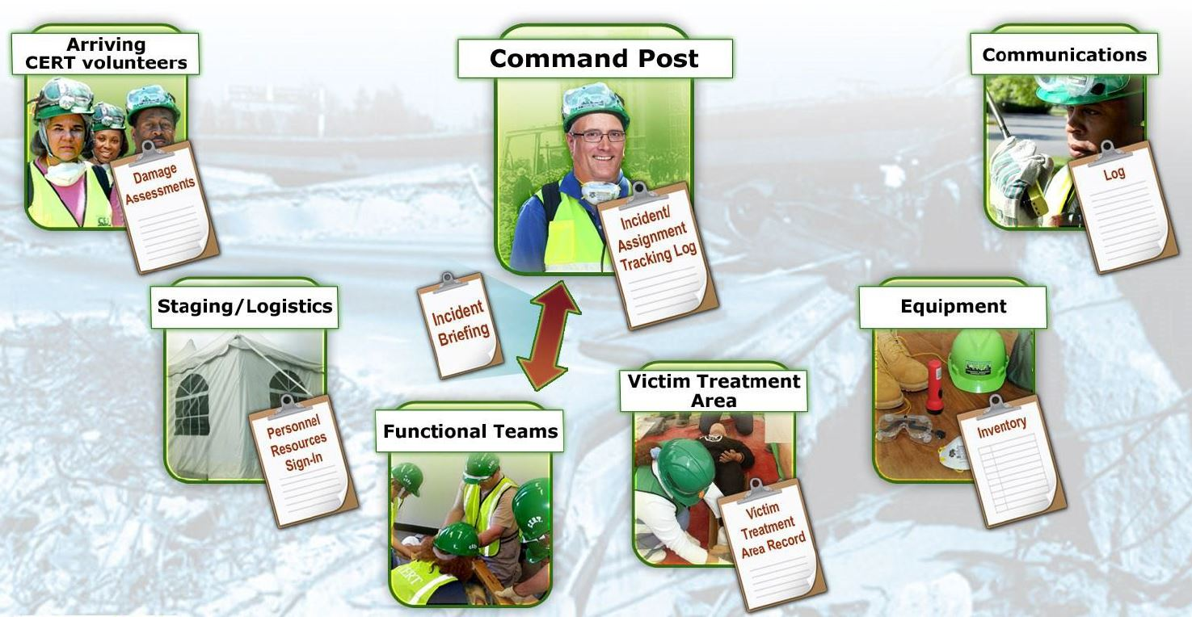
Documentation Flow (5 of 5)
PM 2-13
CERT Basic Training Unit 2: CERT Organization
2-20

Slide 22
Unit Summary (Unit 2)
ICS provides flexible means of organization
Ask “Is it safe to attempt the rescue?”
Document and communicate information to all CERT levels
Provide Command Post with ongoing information about damage assessment, group status, and needs
Command Post documents and tracks situation status
PM 2-25
CERT Basic Training Unit 2: CERT Organization
2-21

Slide 23
Homework Assignment (Unit 2)
Read unit to be covered in next session
Bring necessary supplies to next session
Wear appropriate clothes to next session
PM 2-25
CERT Basic Training Unit 2: CERT Organization
2-22

