Slide 1
CERT Basic Training

Slide 2
Unit 1: Disaster Preparedness
CERT Basic Training

Slide 3
Setting the Stage
CERTs are able to:
  Assist emergency services personnel when requested in accordance with standard operating procedures (SOPs) developed by the sponsoring agency and by area of training
  Assume some of the same functions as emergency services personnel following a disaster
  Prepare families and communities prior to emergencies and assist neighbors during an emergency when first responders are not immediately available
PM 1-1
CERT Basic Training Unit 1: Disaster Preparedness
1-1

Slide 4
Course Preview
Unit 1: Disaster Preparedness
Unit 2: CERT Organization
Unit 3: Disaster Medical Operations, Part 1
Unit 4: Disaster Medical Operations, Part 2
Unit 5: Disaster Psychology
Unit 6: Fire Safety and Utility Controls
Unit 7: Light Search and Rescue Operations
Unit 8: Terrorism and CERT
PM 1-1
CERT Basic Training Unit 1: Disaster Preparedness
1-2

Slide 5
Unit 1 objectives
Describe the functions of CERT, discuss your role as a CERT volunteer, and explain how CERT fits into your community’s emergency preparedness structure
Describe the types of hazards most likely to affect your communities and their potential impact on people, health, and infrastructure
Prepare yourself and your family for potential disasters your community may face, including learning to create a family disaster plan and emergency preparedness kit
PM 1-1
CERT Basic Training Unit 1: Disaster Preparedness
1-3

Slide 6
Exercise 1.1
Work in groups of five to design and construct a free-standing tower that stands at least 5 feet tall from the bottom of the structure to the top
You will have a total of 10 minutes. Spend the first 5 minutes planning and designing the tower as a group. While you are planning, you should not touch any of the materials
Wait to be told when to begin construction and you will have 5 minutes from that point to complete the tower
PM 1-2
CERT Basic Training Unit 1: Disaster Preparedness
1-4

Slide 7
Community Preparedness Roles
Preparedness is important for communities of all sizes across the Nation
  Key priority in lessening the impact of disasters
  Critical that all community members take steps to prepare
  Effective when addresses unique attributes of community and engages whole community
PM 1-3
CERT Basic Training Unit 1: Disaster Preparedness
1-5

Slide 8
Government
Government has responsibility to:
  Develop, test, and refine emergency plans
  Ensure emergency responders have adequate skills and resources
  Provide services to protect and assist citizens
PM 1-3
CERT Basic Training Unit 1: Disaster Preparedness
1-6

Slide 9
Emergency Operations Plan (EOP)
All government agencies with a role in disaster response work to organize and coordinate their agencies’ activities before an emergency or disaster using EOP’s:
  Assigns responsibility to organizations and individuals
  Sets forth lines of authority
  Describes how people and property will be protected
  Identifies personnel, equipment, facilities, supplies, and other resources
PM 1-3
CERT Basic Training Unit 1: Disaster Preparedness
1-7

Slide 10
Community Leaders
Have a responsibility to participate in community preparedness:
  Participate on local collaborative planning council
  Identify and integrate appropriate resources into government plans
  Ensure facilities, staff, and customers served are prepared
PM 1-4
CERT Basic Training Unit 1: Disaster Preparedness
1-8

Slide 11
The Public
Learn about community alerts, warnings, and evacuation routes
Take training
Practice skills and personal plans
Network and help others
Provide feedback to community
Report suspicious activity
Volunteer
PM 1-4
CERT Basic Training Unit 1: Disaster Preparedness
1-9

Slide 12
Engaging the Whole Community
Whole Community approach to emergency preparedness seeks to engage the full capacity of society
Relationships and social connections are the foundation for a more resilient community that can bounce back after a disaster
Community coalitions strengthen relationships and provide a framework for organizing community preparedness efforts
PM 1-4
CERT Basic Training Unit 1: Disaster Preparedness
1-10

Slide 13
Get Involved
Preparedness requires active participation from all
  Talk to friends and family about hazards
  Ask about emergency planning outside the home
  Make sure those in charge have a plan
Training provides skills needed to help others and keeps skills current
  CERT program provides training, practice, and connection to others
  Participate in drills and exercises
  Talk to friends and family about volunteering
PM 1-5
CERT Basic Training Unit 1: Disaster Preparedness
1-11

Slide 14
Type of Disasters
Natural (e.g., earthquakes, wildfires, floods, extreme heat, hurricanes, landslides, thunderstorms, tornadoes, tsunamis, volcanic eruptions, winter storms)
Technological & Accidental (e.g., hazardous material spill, nuclear power plant accident)
Terrorism (e.g., chemical, biological, radiological, nuclear, explosive weapons)
PM 1-6
CERT Basic Training Unit 1: Disaster Preparedness
1-12

Slide 15
Key Disaster Elements
They are relatively unexpected
Emergency personnel may be overwhelmed
Lives, health, and the environment are endangered
PM 1-6
CERT Basic Training Unit 1: Disaster Preparedness
1-13

Slide 16
Local Hazard Vulnerability
Identify most common disasters that occur
Identify possible hazards with most severe impact
Consider recent or historical impacts
Identify susceptible locations in the community for specific hazards
Consider what to expect from disruption of services
PM 1-6
CERT Basic Training Unit 1: Disaster Preparedness
1-14

Slide 17
Infrastructure Damage
Resources will be applied to the highest priority need:
  Police will address incidences of grave public safety
  Firefighters will suppress major fires
  EMS personnel will handle life-threatening injuries
PM 1-7
CERT Basic Training Unit 1: Disaster Preparedness
1-15

Slide 18
Damage Related to Structure Type
You may not have opportunity to select type of structure when a disaster occurs
Engineered buildings have performed well in most types of disasters
Types of damage vary by structure
Differences in hazards and mitigation between single-family homes and multiple-unit dwellings
PM 1-8
CERT Basic Training Unit 1: Disaster Preparedness
1-16

Slide 19
Home Hazards
Gas line ruptures from water heaters or ranges displaced by shaking, water, or wind
Damage from falling books, dishes, or other cabinet contents
Risk of injury or electric shock from displaced appliances and office equipment
Fire from faulty wiring, overloaded plugs, frayed electrical cords
PM 1-9
CERT Basic Training Unit 1: Disaster Preparedness
1-17

Slide 20
Preparing for a Disaster(1 of 2)
Know local hazards, alerts, warning systems, evacuation routes, and sheltering plans
Consider important elements of disaster preparedness
Address specific needs for yourself and people you know
PM 1-10
CERT Basic Training Unit 1: Disaster Preparedness
1-18

Slide 21
Preparing for a Disaster((2 of 2)
Have the skills to evaluate the situation quickly and take effective action to protect yourself
Have a family disaster plan and practice the plan with drills
Assemble supplies in multiple locations
Reduce the impact of hazards through mitigation practices
Get involved by participating in training and volunteer programs
PM 1-10
CERT Basic Training Unit 1: Disaster Preparedness
1-19

Slide 22
Family Disaster Plan
Where will you meet family members?
Who is your out-of-state “check-in” contact?
Will you have an extended stay? Shelter in place? Evacuate?
How will you escape your home? Workplace? School? Place of worship?
What route (and several alternates) will you use to evacuate your neighborhood?
Do you have transportation?
Did you practice your plan?
PM 1-12
CERT Basic Training Unit 1: Disaster Preparedness
1-20

Slide 23
Disaster Supply Kit
After disaster strikes, you will not have time to shop or search for supplies
If you gather supplies in advance, you and your family will be better equipped for an evacuation or home confinement
Many of the items needed for your kits are already in your household
  These items can be assembled in appropriate locations for quick access in an emergency but used under normal circumstances whenever needed
PM 1-13
CERT Basic Training Unit 1: Disaster Preparedness
1-21

Slide 24
Escape Planning
Consider needs of children and individuals with access and functional needs
Inform all family members or office coworkers of the plan
Run practice escape drills
PM 1-17
CERT Basic Training Unit 1: Disaster Preparedness
1-22

Slide 25
Exercise 1.2
Take the scenario given and decide what things to bring with you and/or what to do in the time available
PM 1-18
CERT Basic Training Unit 1: Disaster Preparedness
1-23

Slide 26
Protective Actions
Assess situation
Decide to stay or change locations
  This is a critical early decision in disasters
Seek clean air and protect breathing passages
Protect from debris and signal if trapped
Remove contaminants
Practice good hygiene
PM 1-18
CERT Basic Training Unit 1: Disaster Preparedness
1-24

Slide 27
Sheltering
Shelter in place: sealing a room
  Identify internal room
  Stay for several hours
  Store supplies
Shelter for extended stay
  Stay for several days or up to 2 weeks
  Store emergency supplies
Mass care or community shelter
  Take 3-day disaster kits
  Shelters provide most supplies
PM 1-19
CERT Basic Training Unit 1: Disaster Preparedness
1-25

Slide 28
Mitigation
Mitigation is the reduction of loss of life and property by lessening the impact of disasters and includes any activity that prevents an emergency or reduces effects of hazards
CERT members should have adequate homeowners coverage
  Add flood insurance if in a flood hazard area
PM 1-20
CERT Basic Training Unit 1: Disaster Preparedness
1-26

Slide 29
Structural Mitigation Measures
Bolt houses to foundations
Install trusses or hurricane straps to reinforce roof
Strap propane tanks and chimneys
Strap mobile homes to their slabs
Raise utilities
Build a safe room
PM 1-20
CERT Basic Training Unit 1: Disaster Preparedness
1-27

Slide 30
Non-Structural Hazard Mitigation
Anchor heavy furniture
Secure appliances and office equipment
Childproof cabinet doors
Locate and label gas, electricity, and water shutoffs
Secure water heaters and have flexible gas lines installed
Install hurricane storm shutters
PM 1-20
CERT Basic Training Unit 1: Disaster Preparedness
1-28

Slide 31
Fortifying Your Home
Non-structural hazard mitigation by disaster type:
  Home fires: Burglar bars and locks on outside window entries easy to open from the inside
  Landslides: Flexible fittings are more breakage resistant
  Wildfires: Reduce fuel sources
    Avoid wooden shakes and shingles
    Clear flammable vegetation up to 30 feet from home and remove climbing vines from walls of home
PM 1-21
CERT Basic Training Unit 1: Disaster Preparedness
1-29

Slide 32
CERT Disaster Response
CERTs respond post-disaster by:
  Treating life-threatening injuries until professional assistance is available
  Helping disaster survivors cope with their emotional stressors
  Locating and turning off utilities, if safe to do so
  Extinguishing small fires
  Conducting light search and rescue operations
PM 1-22
CERT Basic Training Unit 1: Disaster Preparedness
1-30

Slide 33
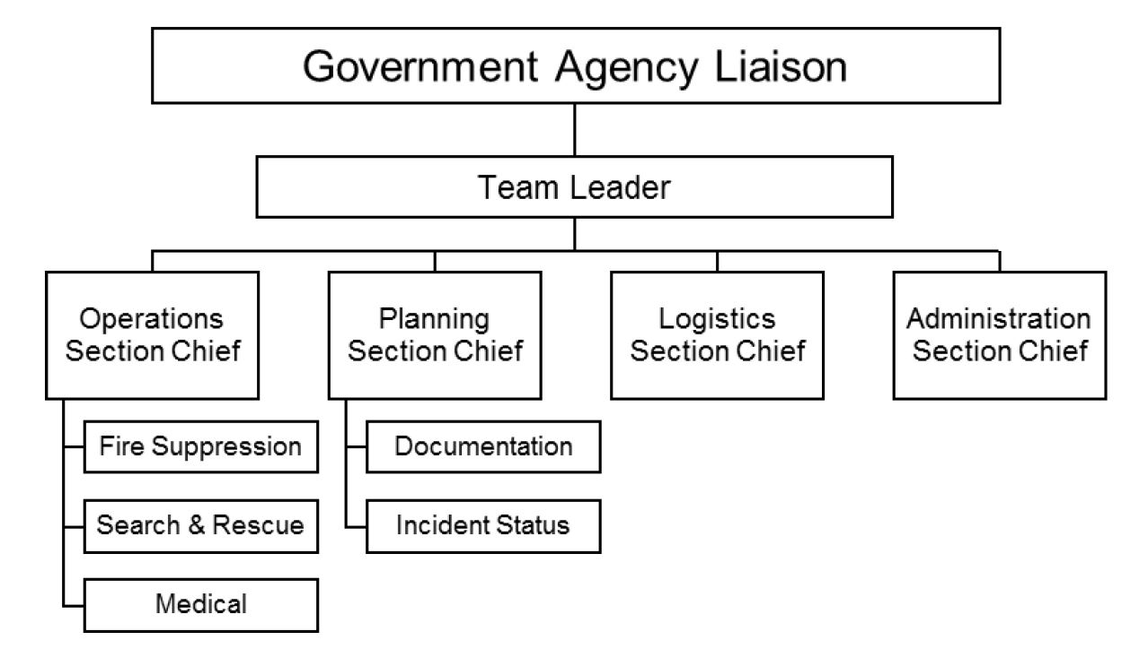
CERT Organization
PM 1-23
CERT Basic Training Unit 1: Disaster Preparedness
1-31

Slide 34
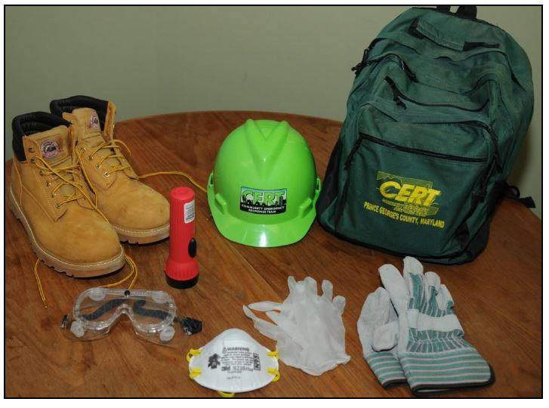
Personal Protective Equipment
Helmet
Goggles
N95 Mask
Gloves (work and non-latex)
Sturdy shoes or work boots
PM 1-24
CERT Basic Training Unit 1: Disaster Preparedness
1-32

Slide 35
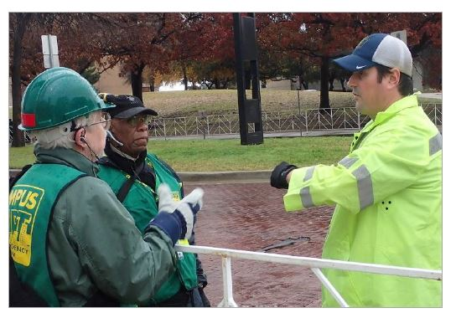
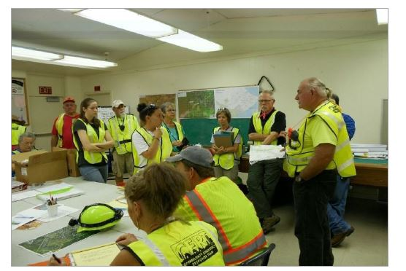
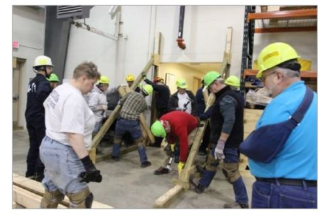
CERT in Action
PM 1-24
CERT Basic Training Unit 1: Disaster Preparedness
1-33

Slide 36
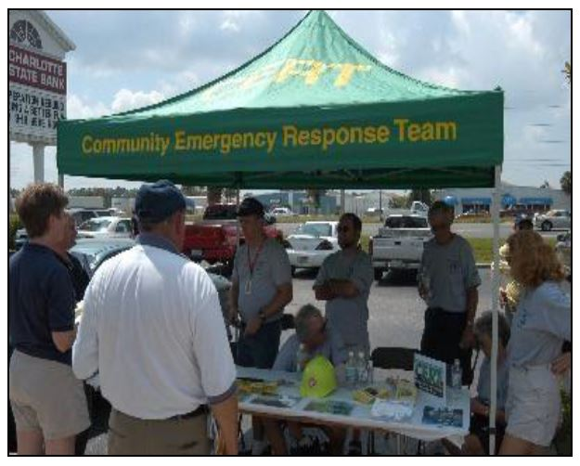
Non-Disaster Roles
Identify and aid neighbors/coworkers who might need assistance
Distribute preparedness materials; do demos
Staff first aid booths at special events
Assist with installation of smoke alarms
Participate in parade route management
PM 1-24
CERT Basic Training Unit 1: Disaster Preparedness
1-34

Slide 37
Protection for Disaster Workers
CERT members are generally protected by:
  “Good Samaritan” laws
  Volunteer Protection Act of 1997
  Relevant State statutes
PM 1-24
CERT Basic Training Unit 1: Disaster Preparedness
1-35

Slide 38
Additional Training
Advanced first aid
Animal issues in disasters
Automated External Defibrillator (AED) use
Community relations
CPR skills
Debris removal
Donations management
Shelter management
Special needs concerns
Traffic/crowd control
Utilities control
Online courses
PM 1-26
CERT Basic Training Unit 1: Disaster Preparedness
1-36

Slide 39
Unit Summary (Unit 1)
You should now be able to:
  Identify roles and responsibilities for community preparedness
  Describe types of hazards that affect communities, people, health, and infrastructure
  Undertake personal and organizational preparedness actions
  Describe functions of CERTs
PM 1-27
CERT Basic Training Unit 1: Disaster Preparedness
1-37

Slide 40
Homework Assignment (Unit 1)
Review the detailed information in Unit 1 of the Participant Manual
Read and familiarize yourself with Unit 2: CERT Organization in the Participant Manual
Discuss preparedness with family and friends and make a communications plan, including an out-of-state “check-in contact ”
Begin to assemble supplies in multiple locations
Examine your home for hazards and identify ways to prevent potential injury
PM 1-27
CERT Basic Training Unit 1: Disaster Preparedness
1-38

